Slide 1
بِسْمِ ٱللَّٰهِ ٱلرَّحْمَٰنِ ٱلرَّحِيمِ
وَمَا تَوْفِيقِي إِلَّا بِاللَّهِ

Slide 2



Password Strength Analysis
Enhancing Digital Security Through Strong Passwords
Powered By Cybersecurity
Next Frontier of Protection

Slide 3


Project Objective Content
INTRO
Educate User’s on Creating Strong Password’s
Understanding The Risk Associated With The Weak Password’s
Introducing The Software Tool
Real-World Impact
Future Enhancement’s
Final Thought’s

Slide 4

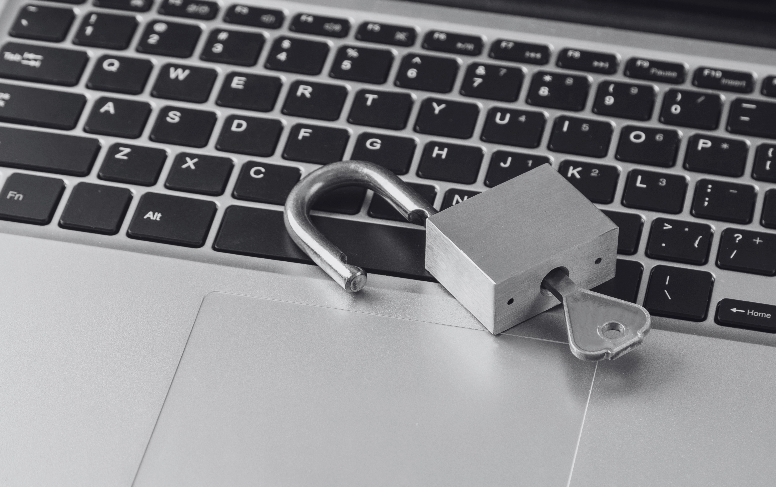



Password
a string of characters that allows access to
a computer system or service.
a secret word or phrase that must be used to
gain admission to a place.
Role Of Password in Security
Protect sensitive information
Personal information
Financial information & Confidential business data
Prevent identity theft
Minimizing the risk of online fraud.
Protect networks and systems
Protect sensitive info from unauthorized access.
"if you don't know the password you can't come in"

Slide 5


Password Analysis
Password analysis is the process of evaluating how strong a password is and how well it protects against unauthorized access.
Importance
Identifying weak passwords and making them stronger. Protecting sensitive information from hackers.
Types of Password Analysis
Static Analysis
Evaluating the risks associated with fixed passwords.
Dynamic Analysis
Analyzing the security aspects of dynamic or one-time passwords.
Behavioral Analysis
Studying the user's password usage patterns and account activities.

Slide 6

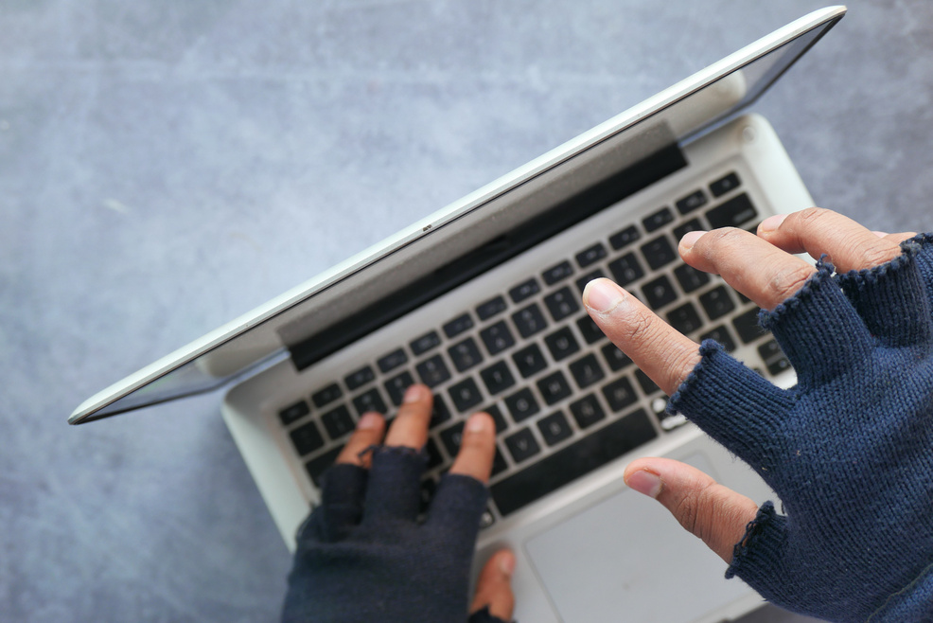
Strong Password
Strong Password’s protects our electronic accounts & devices from unauthorized access, keeping our sensitive personal information safe.
Guidelines
Avoid Re-using
Use Substitute Character’s
Use a Password Manager
Same Password
& Mix Elements
Change passwords regularly.
Avoid using the same one for too long for other Account’s.
By replacing some letters with
similar-looking numbers or symbols
“P@ssw0rd”
Use combination of uppercase, lowercase, numbers, and symbol’s.
using a password manager to generate and store complex passwords.

Slide 7





Characteristic’s of Strong Password
2
3
Unpredictability: Avoid using easily guessable information like birthdays, names, or common words
Password should be unique.
Complexity:
Contains a mixture of uppercase letters, lowercase letters, numbers, and special characters.
1
4
Avoid Common Patterns:
Don’t use sequential numbers (e.g., 12345) & keyboard patterns (e.g., asdfg).
Length :
Should be at least 12 characters long.

Slide 8


Weak Password’s
A password that is easy to guess or can be easily cracked by an unauthorized user.
Why Weak Password Occur
Ease of Remembering
Lack of Knowledge
Choosing Such Passwords That can easily remember.
Don’t know how to make a Strong Password.
Underestimating The Risk
Password Re-use
Underestimating the Risk of Cybersecurity
64% of passwords are only eight to 11 characters long
Re-using the pass across multiple accounts.
44% of employees use the same login credentials for both personal and work-related accounts.

Slide 9

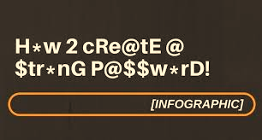
Why Password Strength Matter’s
Weak passwords are a major vulnerability in cybersecurity.
81% of hacking-related breaches are due to stolen or weak passwords.
Average time to crack a weak password: < 1 second.
Solution to threat is real-time password analysis and improvement.

Slide 10



Security Breaches due to Weak Password
Unauthorized Access
Accessing personal accounts or business data bases.
Data breaches
Accessing confidential data, such as personal information or trade secrets.
Identity Theft
Can be used to apply for credit , impersonate individuals or engage in fraudulent activities.
Account Takeover
Using same pass to login in into other accounts

Slide 11
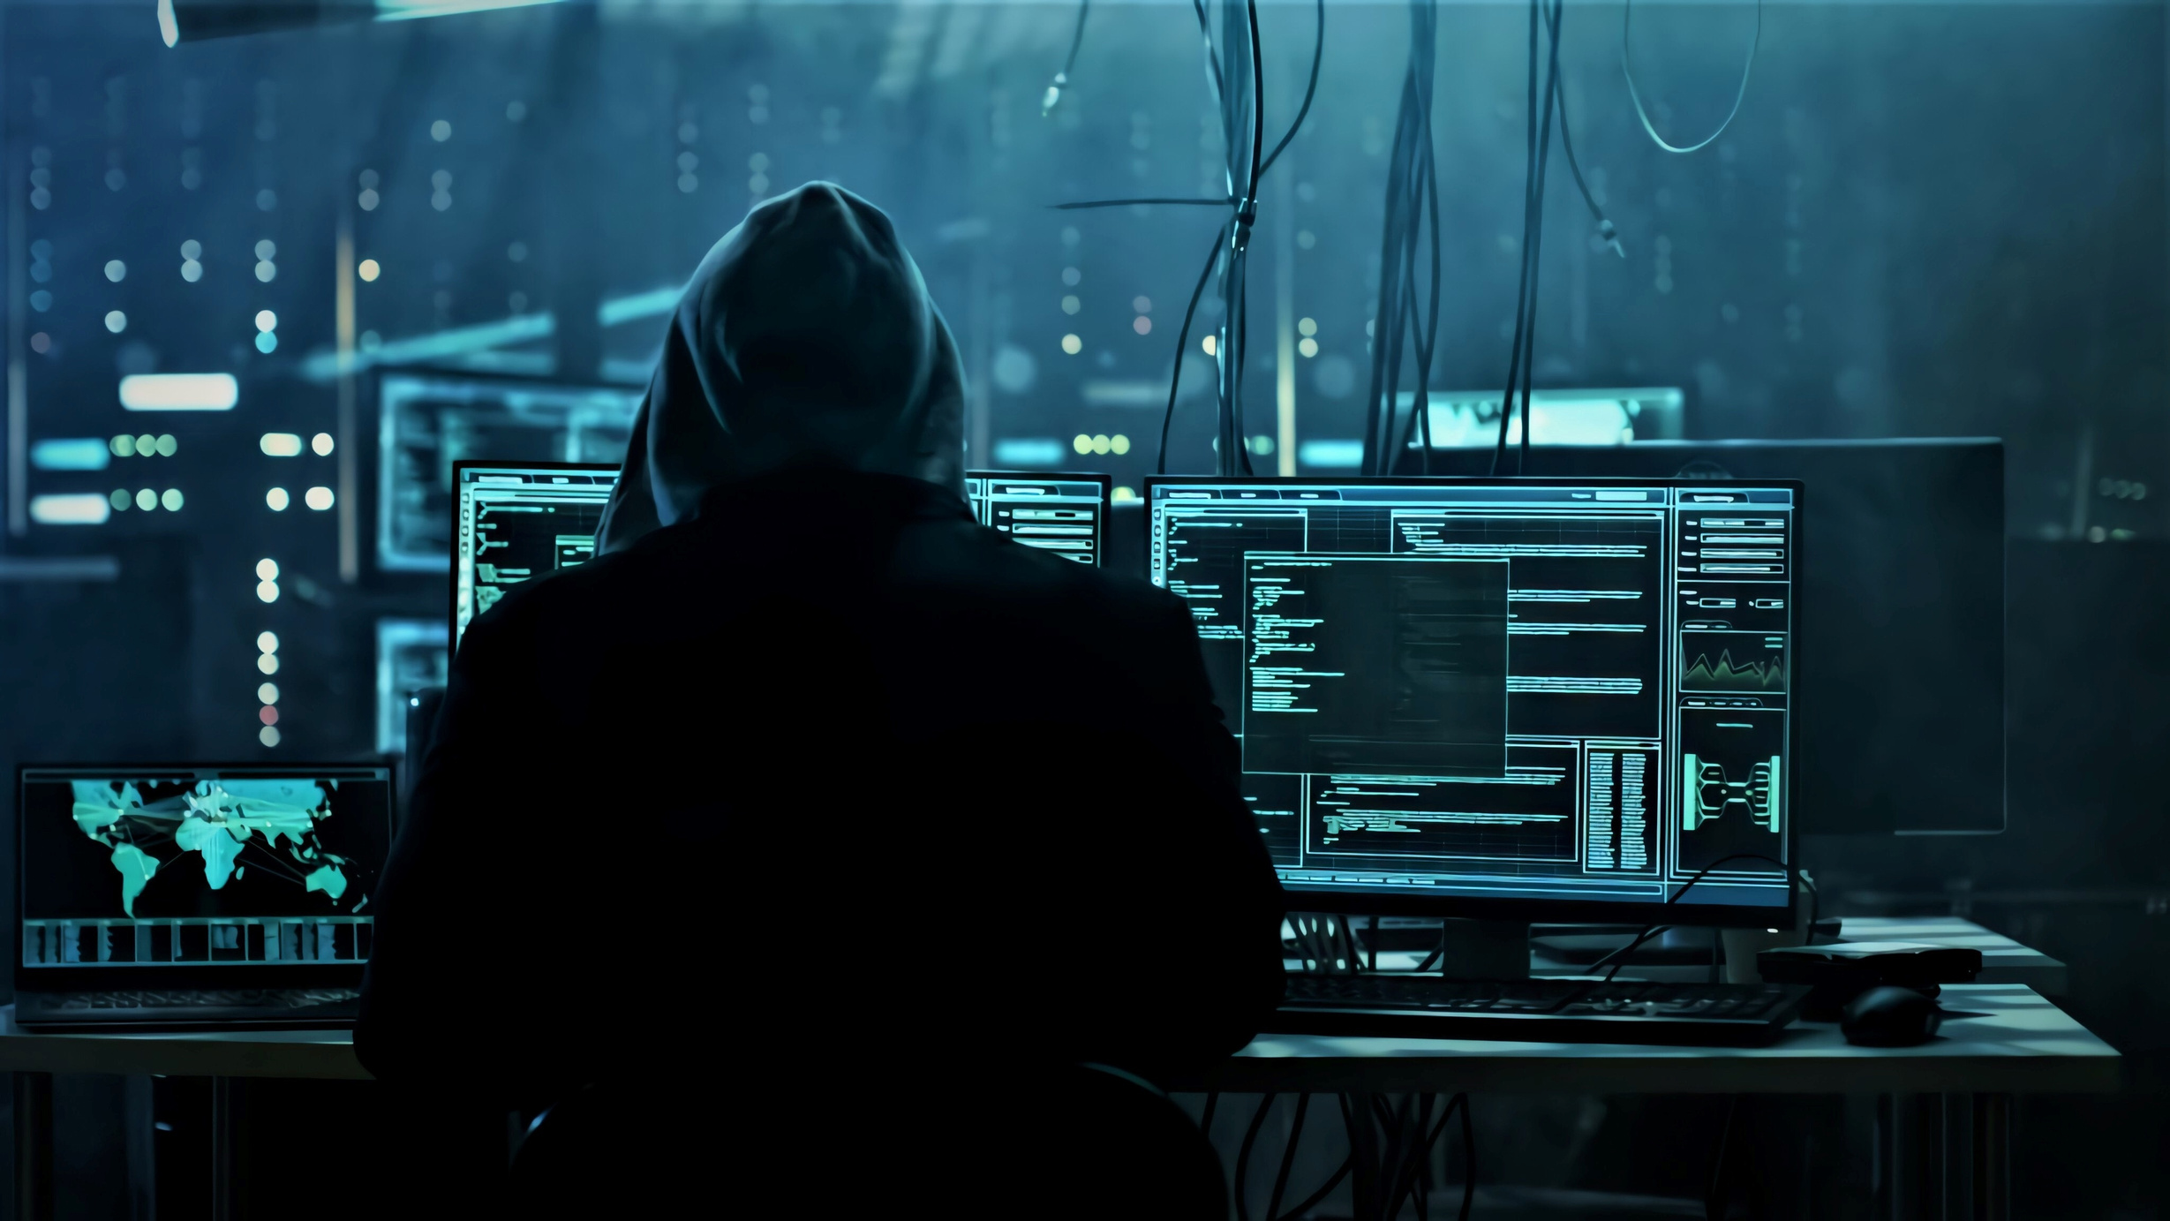
Way’s Through which Hacker’s can exploit Weak Password’s
Phishing
01
Sending emails, instant messages, or websites & showing yourself a legitimate user to trick users for getting info.
Key Loggers
02
A type of malware use to record keystrokes on an infected device
Brute Force
03
Trying a large number of password combinations until finds out the correct one.

Slide 12


Introducing Password Strength Analysis Tool
This innovative tool aims to simplify password security for users of all levels. It makes it easy to check the strength of any password and to generate strong passwords.
Powered By C++
Programmer Updated

Slide 13

Feature’s Of The Tool
1
2
Password History Tracking
Stores the date, strength, and password.
Security Tips
Provides tips for creating strong passwords
………………….
………………………..….
3
z
4
Password Generation
Generates a random strong password & Calculates the entropy (strength)
Strength Suggestion and Improvements
…………………..….
…………………..….
5
6
Password Strength
Check
Strength of a given password based on criteria (length, character types).
…………………..….
Interactive User Interface
Menu Options
User Prompts
……………………....….

Slide 14

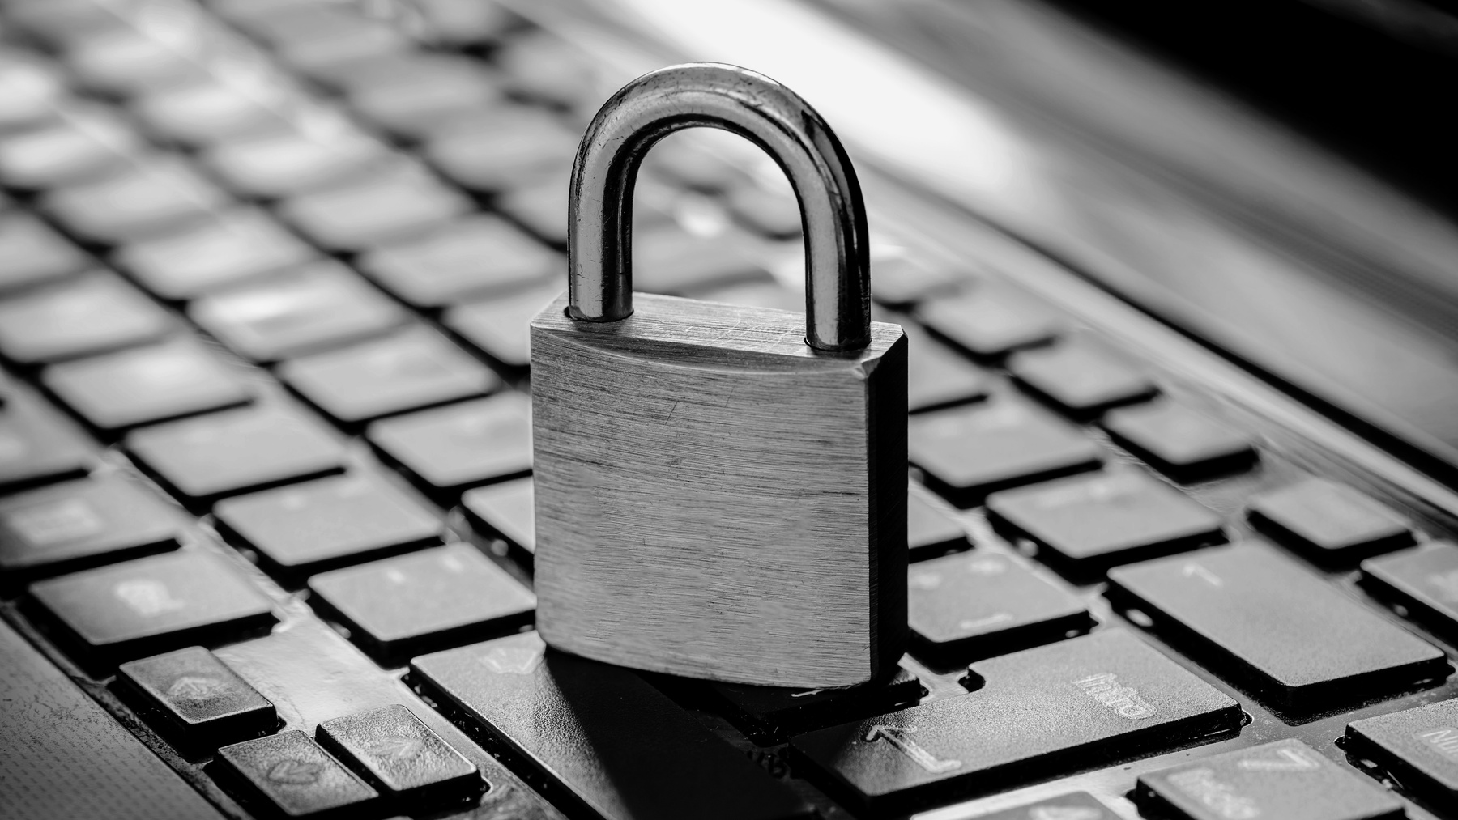
Work-Flow Of The Tool
Prompts the user to enter a password.
Analyzes the strength of the entered password based on length and character variety.
Calculates and displays the password's entropy.
Checks if the password is common.
Provides feedback and suggestions for improving the password.
Offers to generate a strong password if the entered password is weak.
Adds the analyzed password to the history.
Provides options to check another password, view history, see tips, or exit.

Slide 15
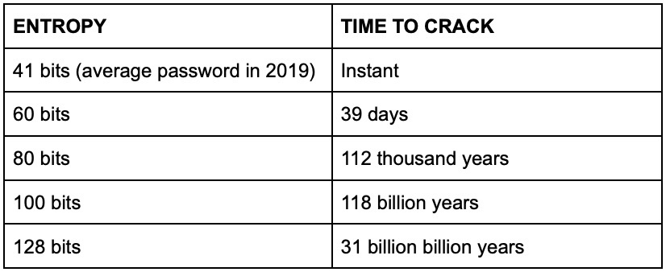
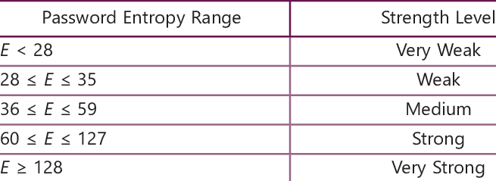
Password Strength Criteria
Entropy
In the context of passwords, measures the randomness and unpredictability of a password
->It helps to determine how difficult it is for someone to guess or crack the password
Entropy Calculation
Higher entropy = stronger password.
->Formula
entropy= L*log2 (N)
where L = length and N = character pool size

Slide 16




Tool Demonstration
🔒 Password Strength Analysis Tool!!!...
Enter Your Password to check its Strength:
Abdul123

Slide 17
Tool Demonstration
🔒 Password Strength Analysis Tool!!!...
Enter Your Password to check its Strength: Abdul123
Abdul123

Slide 18
Tool Demonstration
🔒 Password Strength Analysis Tool!!!...
Enter Your Password to check its Strength: Abdul123
🔒 Password Strength: ####- Moderate
📊 Password Entropy: 47.6336 bits
Consider adding a special character (!, @, #, etc.).
🤖 Would you like a randomly generated strong password? (yes/no):
Abdul123
Yes

Slide 19
Tool Demonstration
🔒 Password Strength Analysis Tool!!!...
Enter Your Password to check its Strength: Abdul123
🔒 Password Strength: ####- Moderate
📊 Password Entropy: 47.6336 bits
Consider adding a special character (!, @, #, etc.).
🤖 Would you like a randomly generated strong password? (yes/no):Yes
Abdul123
Yes

Slide 20
Tool Demonstration
🔒 Password Strength Analysis Tool!!!...
Enter Your Password to check its Strength: Abdul123
🔒 Password Strength: ####- Moderate
📊 Password Entropy: 47.6336 bits
Consider adding a special character (!, @, #, etc.).
🤖 Would you like a randomly generated strong password? (yes/no):Yes
🎲 Generated strong password: Bj6!H!#o :
Menu:
1. Check Another Password
2. View Password History
3. See Security Tips
4. Exit
Enter your choice:
Abdul123
Yes

Slide 21
Tool Demonstration
🔒 Password Strength Analysis Tool!!!...
Enter Your Password to check its Strength: Abdul123
🔒 Password Strength: ####- Moderate
📊 Password Entropy: 47.6336 bits
Consider adding a special character (!, @, #, etc.).
🤖 Would you like a randomly generated strong password? (yes/no):Yes
🎲 Generated strong password: Bj6!H!#o :
Menu:
1. Check Another Password
2. View Password History
3. See Security Tips
4. Exit
Enter your choice:
Abdul123
Yes
2

Slide 22
Tool Demonstration
🔒 Password Strength Analysis Tool!!!...
Enter Your Password to check its Strength: Abdul123
🔒 Password Strength: ####- Moderate
📊 Password Entropy: 47.6336 bits
Consider adding a special character (!, @, #, etc.).
🤖 Would you like a randomly generated strong password? (yes/no):Yes
🎲 Generated strong password: Bj6!H!#o :
Menu:
1. Check Another Password
2. View Password History
3. See Security Tips
4. Exit
Enter your choice: 2
Abdul123
Yes
2

Slide 23
Tool Demonstration
🔒 Password Strength Analysis Tool!!!...
Enter Your Password to check its Strength:Abdul123
🔒 Password Strength: ####- Moderate
📊 Password Entropy: 47.6336 bits
Consider adding a special character (!, @, #, etc.).
🤖 Would you like a randomly generated strong password? (yes/no): Yes
🎲 Generated strong password: Bj6!H!#o :
Menu:
1. Check Another Password
2. View Password History
3. See Security Tips
4. Exit
Enter your choice: 2
📅 Date: Thu Dec 26 09:25:26 2024
🔒 Strength: Moderate
🔑 Password: Abdul123
Abdul123
Yes
2

Slide 24
Tool Demonstration
Menu:
1. Check Another Password
2. View Password History
3. See Security Tips
4. Exit
Enter your choice:
Abdul123
Yes
2
3

Slide 25
Tool Demonstration
Menu:
1. Check Another Password
2. View Password History
3. See Security Tips
4. Exit
Enter your choice: 3
Abdul123
Yes
2
3

Slide 26
Tool Demonstration
Menu:
1. Check Another Password
2. View Password History
3. See Security Tips
4. Exit
Enter your choice: 3
🛡 Security Tips:
- Use a mix of uppercase, lowercase, digits, and special characters.
- Avoid common words and phrases.
- Do not reuse passwords across multiple sites.
- Change your passwords regularly.
Abdul123
Yes
2
3

Slide 27
Tool Demonstration
Menu:
1. Check Another Password
2. View Password History
3. See Security Tips
4. Exit
Enter your choice: 3
🛡 Security Tips:
- Use a mix of uppercase, lowercase, digits, and special characters.
- Avoid common words and phrases.
- Do not reuse passwords across multiple sites.
- Change your passwords regularly.
Menu:
1. Check Another Password
2. View Password History
3. See Security Tips
4. Exit
Enter your choice:
Abdul123
Yes
2
3

Slide 28
Tool Demonstration
Menu:
1. Check Another Password
2. View Password History
3. See Security Tips
4. Exit
Enter your choice: 3
🛡 Security Tips:
- Use a mix of uppercase, lowercase, digits, and special characters.
- Avoid common words and phrases.
- Do not reuse passwords across multiple sites.
- Change your passwords regularly.
Menu:
1. Check Another Password
2. View Password History
3. See Security Tips
4. Exit
Enter your choice:
Abdul123
Yes
2
3
4

Slide 29
Tool Demonstration
Menu:
1. Check Another Password
2. View Password History
3. See Security Tips
4. Exit
Enter your choice: 3
🛡 Security Tips:
- Use a mix of uppercase, lowercase, digits, and special characters.
- Avoid common words and phrases.
- Do not reuse passwords across multiple sites.
- Change your passwords regularly.
Menu:
1. Check Another Password
2. View Password History
3. See Security Tips
4. Exit
Enter your choice: 4
Abdul123
Yes
2
3
4

Slide 30
Tool Demonstration
Menu:
1. Check Another Password
2. View Password History
3. See Security Tips
4. Exit
Enter your choice: 3
🛡 Security Tips:
- Use a mix of uppercase, lowercase, digits, and special characters.
- Avoid common words and phrases.
- Do not reuse passwords across multiple sites.
- Change your passwords regularly.
Menu:
1. Check Another Password
2. View Password History
3. See Security Tips
4. Exit
Enter your choice: 4
Thank You!
Abdul123
Yes
2
3
4

Slide 31




Real World Impact
Personal information
Cyber threat’s
Strong passwords help keep your personal information safe, including your emails, files, and other content
Using weak passwords can expose systems and users to cyber threats.
1
2
3
Data breaches
Over 80% of data breaches in 2020 involved lost or stolen credentials.
We also found that 81% of data breaches were due to weak, default, or stolen passwords.

Slide 32




Future Enhancement’s
Biometric data is more difficult to replicate or steal than passwords
Using unique physical characteristics -> fingerprints, facial recognition, or iris scans, to verify identity.
The next generation of passwords, created using public key cryptography
Biometric authentication
Access accounts without entering a password.
Use biometrics, one-time codes, or security keys to verify Ur identity.
Passkeys
Cryptography is the practice of encoding or hiding information so that only the intended recipient can read it
Password less authentication

Slide 33
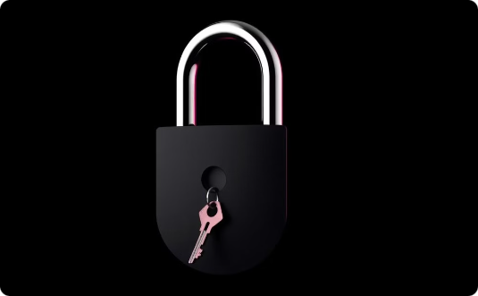


Final Thought’s
Call to Action
“Strengthen your passwords and enhance your security today!”
Powered by C++
Efficient -Secure &
Reliable Tool
Key Takeaways
Password strength is vital for cybersecurity.

Slide 34



THANK
+92-303********
www.reallygreatsite.com
You !
hello@reallygreatsite.com
Any Question’s……..

